Slide 1
Case Study Use in Health Science Classes
Tyler Hudson MAT, LAT, ATC
North Miami High School
thudson1021@gmail.com

Slide 2
Introduction
Introduce yourself
What school
What classes do you teach
Do you use case studies? If so, how?

Slide 3
Why Use Cases?
Many students are more inductive than deductive reasoners
Students learn better from examples than from logical development starting with basic principles
Case studies have long been used in any discipline when instructors want students to explore how what they have learned applies to real world situations.

Slide 4
Deliverables in Case Studies
Cases come in many formats, from a simple “What would you do in this situation?” question to a detailed description of a situation with accompanying data to analyze.
Most case assignments require students to answer an open-ended question or develop a solution to an open-ended problem with multiple potential solutions.
Requirements can range from a one-paragraph answer to a fully developed group action plan, proposal or decision.

Slide 5
Common Case Elements
Most have these common elements:
A decision-maker who is grappling with some question or problem that needs to be solved.
A description of the problem’s context (a law, an industry, a family).
Supporting data, which can range from data tables to links to URLs, quoted statements or testimony, supporting documents, images, video, or audio.

Slide 6
Connections to the Indiana Standards

Slide 7
Connections to STE(A)M

Slide 8
21st Century Learning and Life Skills
Collaboration
Communication
Creativity
Critical thinking
Flexibility
Social skills
Leadership
Productivity

Slide 9
Indiana Science and Engineering Practices

Slide 10
Indiana Science and Engineering Practices

Slide 11
Advantages to the use of case studies in class
A major advantage of teaching with case studies is that the students are actively engaged in figuring out the principles by abstracting from the examples. This develops their skills in:
Problem solving
Analytical tools, quantitative and/or qualitative, depending on the case
Decision making in complex situations
Coping with ambiguities

Slide 12
Guidelines for using case studies in class
What is the issue?
What is the goal of the analysis?
What is the context of the problem?
What key facts should be considered?
What alternatives are available to the decision-maker?
What would you recommend — and why?
Options for presentations:
students role-play the part of the people involved in the case.
Videos
Field trips

Slide 13
Evaluation
Rubric for feasibility of final recommendation, action plan, proposal
Class participation
Group work
Research completed
Alternatives to recommendation

Slide 14
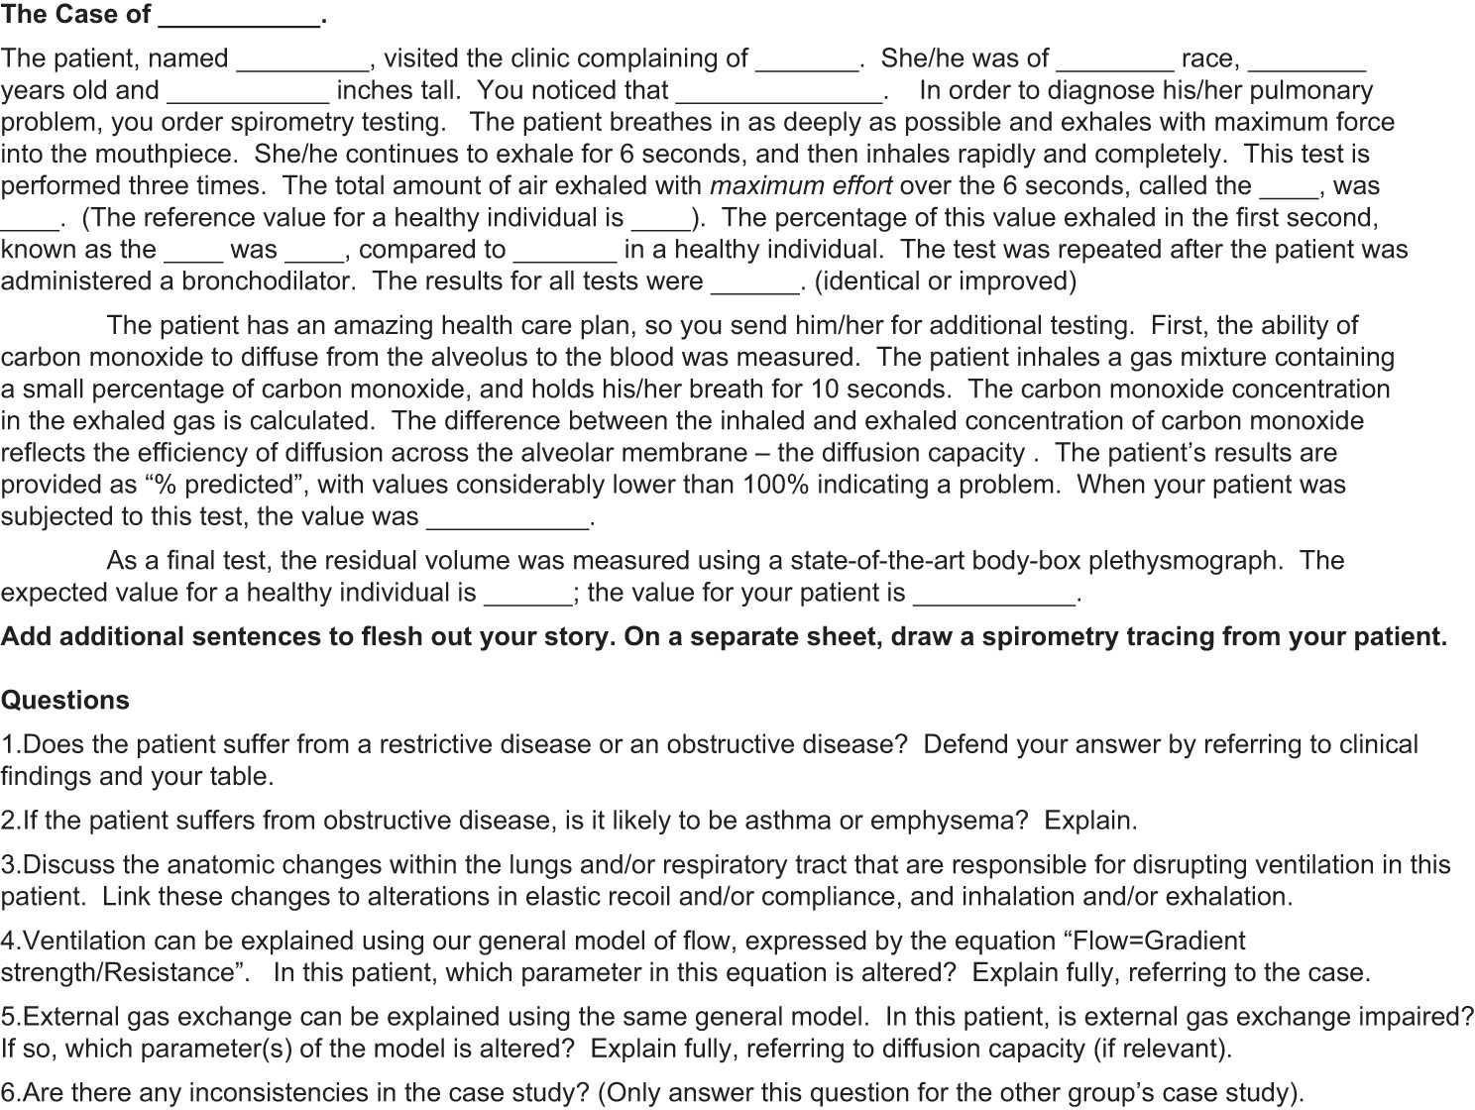

Slide 15
Case Studies Examples to Model the Process
http://bioquest.org/icbl/icbl_details.php?product_id=389
http://bioquest.org/icbl/icbl_details.php?product_id=3786
http://studentsdiscover.org/wp-content/uploads/A-Diversity-of-Guts-Case-Studies.pdf
http://sciencecases.lib.buffalo.edu/files/disputed_maternity.pdf

Slide 16
How to Write a Case Study
Choose the situation on which to write (newspaper, medical sites, TV medical drama show, lawsuits, privacy issues, etc.)
Gather as much background information as possible about the situation but ensuring no opinions are included (key players, stakeholders, patients, etc.)
Analyze all elements surrounding the situation

